Slide 1


Analyzing Medicare Enrollment Trends and Market Dynamics:
Competitive Landscape and Strategic Insights for Texas, Illinois, Oklahoma, New Mexico, and Montana

Slide 2

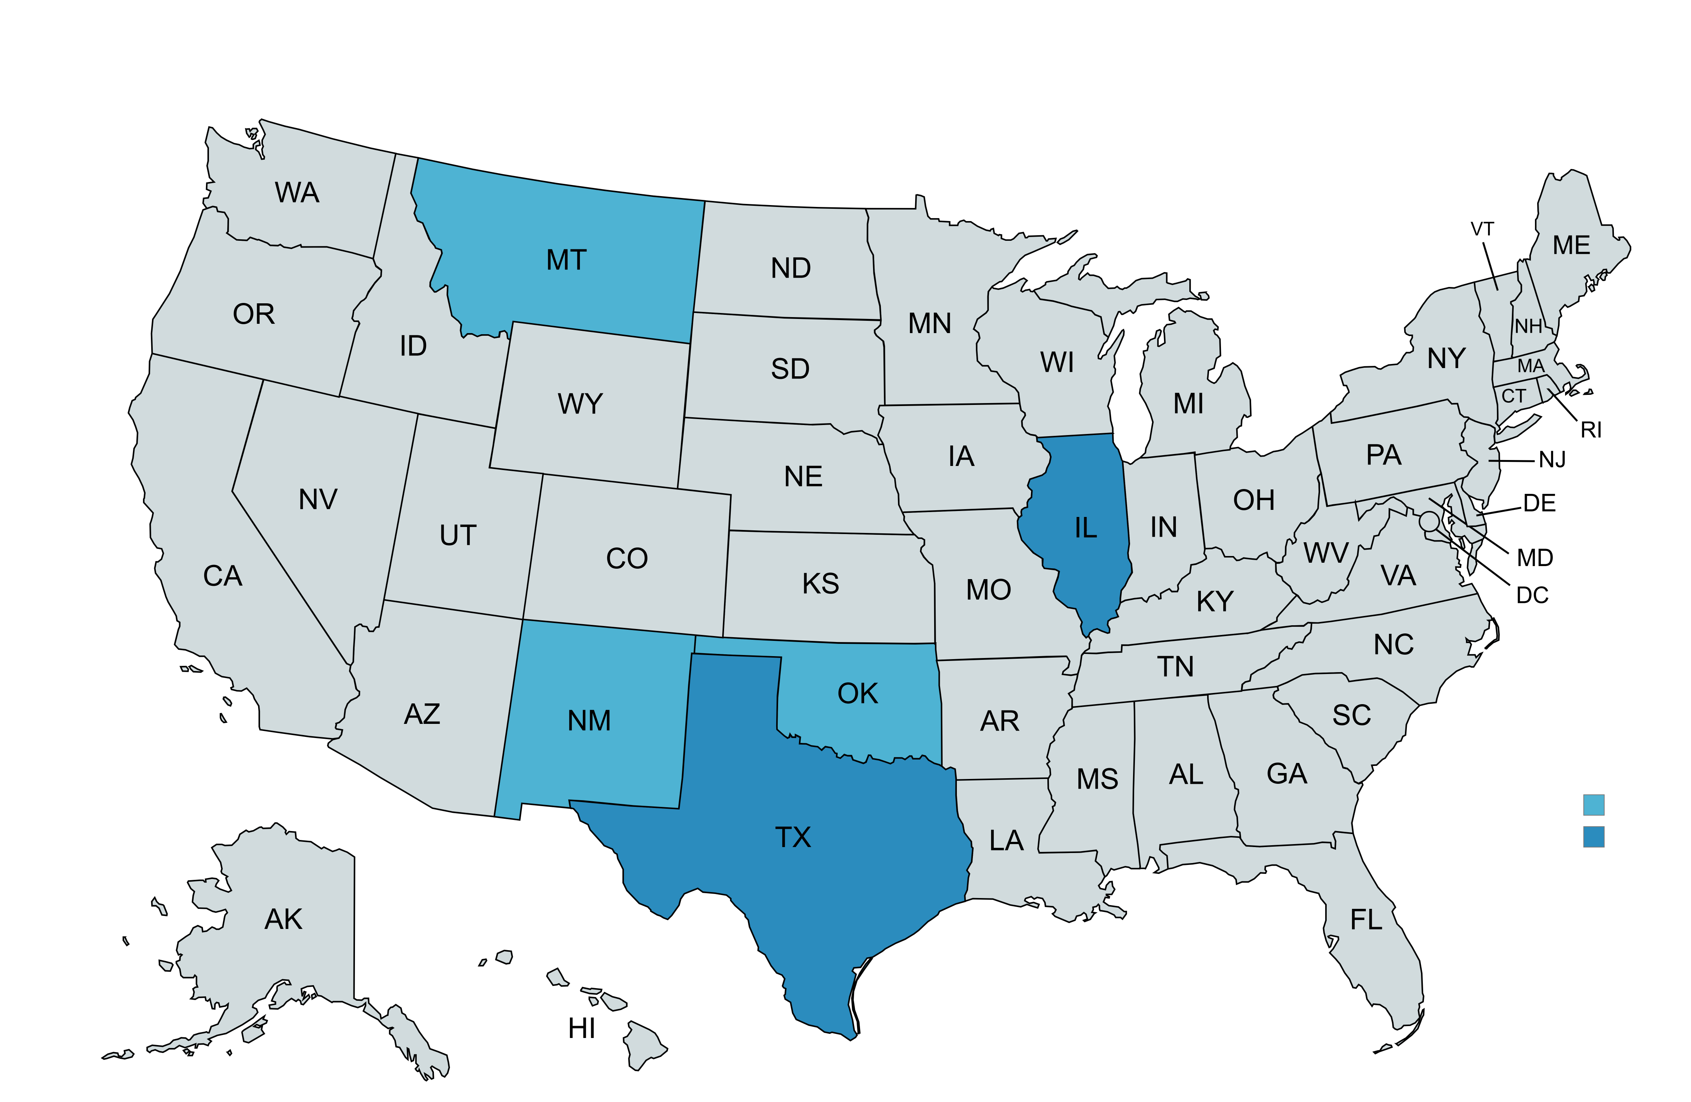

…with more than 80% of the business in Texas and Illinois.
Health Care Service Corporation
Illinois • Montana • New Mexico • Oklahoma • Texas
2

Slide 3



Scope of Work
The Louisiana State University (LSU) Master of Science in Analytics consulting team has been requested by the Health Care Services Corporation (HCSC) to assist in the analysis of Medicare enrollment trends. The purpose of this analysis is to analyze the competitive market of Medicare enrollment, plan offerings, and market penetration in Texas (TX), Illinois (IL), Oklahoma (OK), New Mexico (NM), and Montana (MT).
Seek to identify enrollment numbers, plan offerings, and market opportunities for HCSC since 2021 across the top 5-10 competitors. Given the recent acquisition of The Cigna Group’s Medicare business, this analysis will focus on the competitive climate numbers both before and after the acquisition.
Source public Medicare Advantage/Part D Contract and Enrollment Data datasets to leverage AI software, using Human in the Loop, to compare results against strictly traditional analytical methods, assessing how software like ChatGPT enhances insights, pattern recognition, and decision-making.
The consulting team also aims to source publicly available datasets to evaluate how social determinants of health (SDOH) influence Medicare enrollment and business opportunities in these focus areas, providing a competitive edge in strategic planning.
3

Slide 4

Agenda
01
02
03
04
05
06
07
08
Artificial Intelligence (AI)
Data Sources
Enrollment, Penetration, Plans
Social Determinants of Health
Sentiment Analysis
External Factors
Notable Findings
Additional Tools for Analysis
4

Slide 5
Use of Artificial Intelligence
Enrollment & Plan Offerings
Played a valuable role as a coding partner for processing large datasets
Used as a supportive tool for data cleaning, imputation, and integration – results remained exploratory
Social Determinants of Health
Develop an AI-enabled model to identify counties with higher levels of social and economic stress
Sentiment
Using Natural Language Processing (NLP) techniques powered by AI to conduct sentiment analysis on text data
Delivery
Leveraged AI to cross-verify analysis and enhance the effectiveness of data communication
AI powered tools for further exploration
5

Slide 6






Data Sources & Methodology Overview
Acquisition
Sourced from publicly available datasets including Centers for Medicare & Medicaid Services (CMS.gov), U.S. Census, and American Community Survey (ACS)
Cleaning & Imputation
Primary focus on 5 target states: TX, IL, OK, NM, MT
Addressed data gaps through imputation methods to ensure data completeness and consistency
Integration
Consolidated and harmonized data from multiple sources within Tableau, ensuring alignment across enrollment, demographic, and plan type indicators
Validation & Accuracy Check
Cross-verified enrollment totals against benchmark values:
Total Medicare Enrollment: +/- 68 million
HCSC + Cigna Enrollment: +/- 4.3 million
Derived Metrics
Developed key analytical metrics such as:
Estimated number of individuals not currently enrolled
Market penetration rates by plan and geography
6

Slide 7
101,488 individuals not enrolled
but eligible for Medicare and still in need of care
63,606 in Texas (1.32%)
23,413 in Illinois (0.96%)
6,420 in Oklahoma (0.79%)
5,034 in New Mexico (1.08%)
and 3,015 in Montana (1.14%)
An opportunity ― and a responsibility.
7
Notes:
Data sources:
https://data.cms.gov/summary-statistics-on-beneficiary-enrollment/medicare-and-medicaid-reports/medicare-monthly-enrollment
https://www.cms.gov/data-research/statistics-trends-and-reports/medicare-advantagepart-d-contract-and-enrollment-data/monthly-enrollment-state

Slide 8
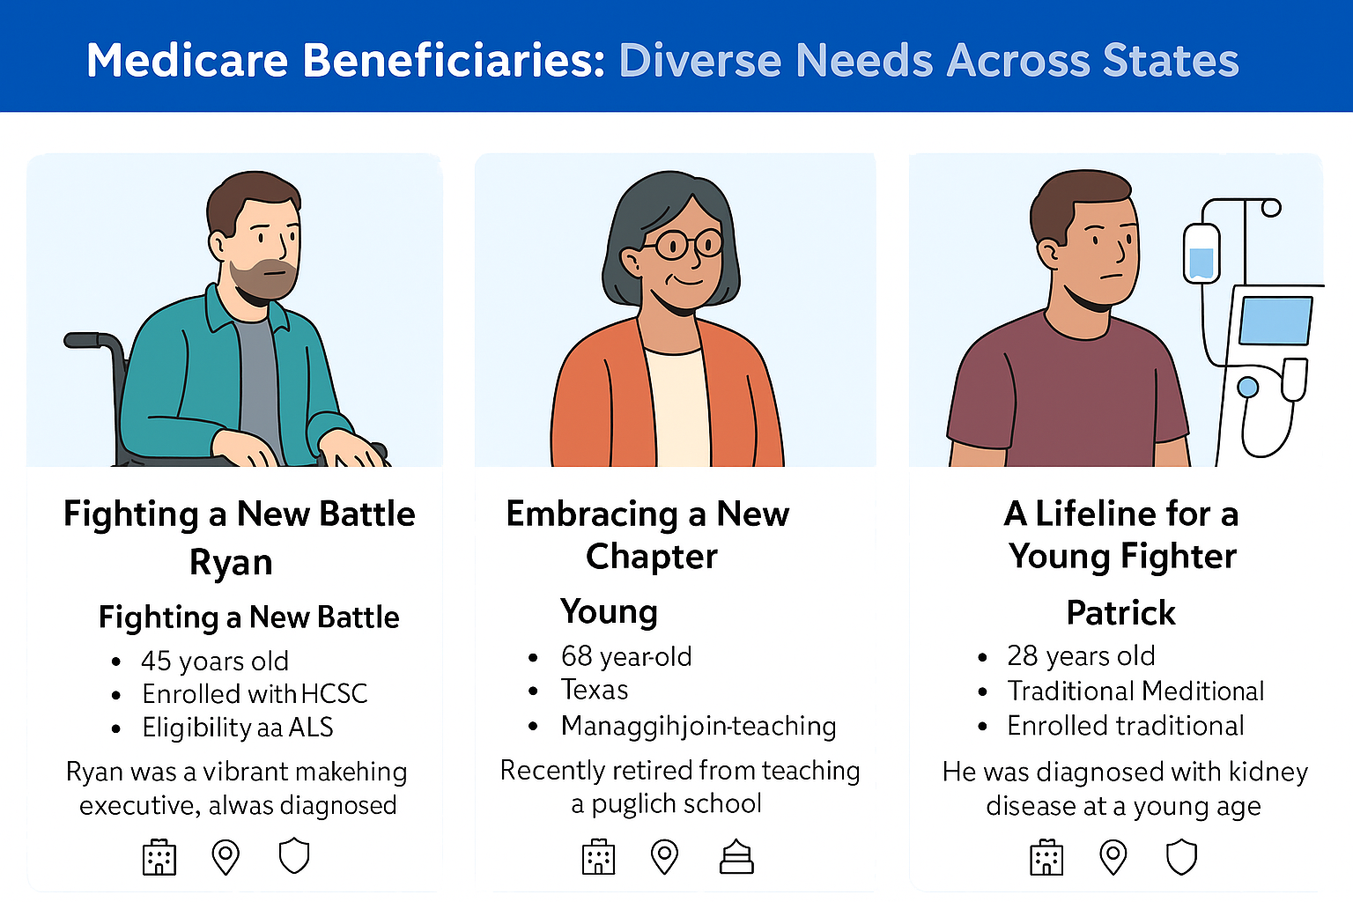
Diverse Needs Across States
90.2% of the eligible population falls under the category of 65 or older
Patrick
Lifeline for a Young Fighter
- Age: 23 years old
- Insurance: Federal Medicare
- Eligibility: Kidney failure
- Location: Rural Oklahoma
Ryan
Fighting a New Battle
- Age: 42 years old
- Insurance: HCSC
- Eligibility: ALS
- Location: Chicago, Illinois
Donna
Embracing a New Chapter
- Age: 68 years old
- Insurance: Cigna
- Eligibility: 65 or older
- Location: Suburban Texas
8

Slide 9
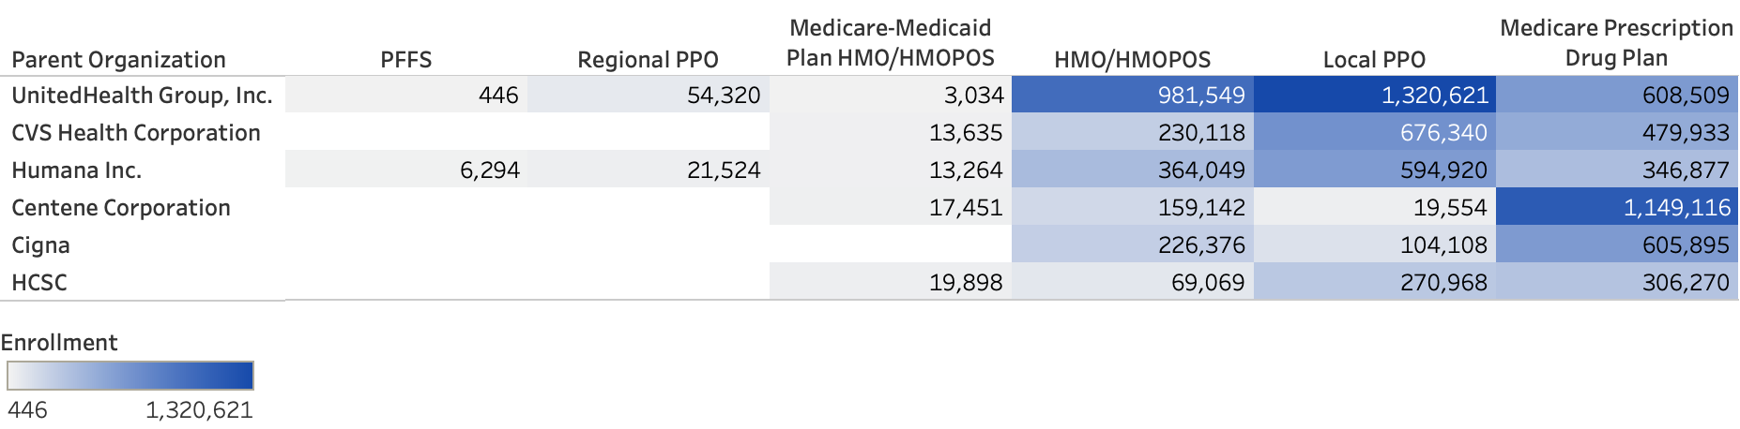

What type of plans are being offered?
✔ Medicare Prescription Drug Plans and Local PPOs lead in overall Medicare enrollment.
✔ UnitedHealth, CVS, and Humana dominate across key plan types with the highest volumes.
✔ HCSC and Cigna show modest offerings, with a stronger presence in Medicare Prescription Drug Plans.
Key Insights
9

Slide 10


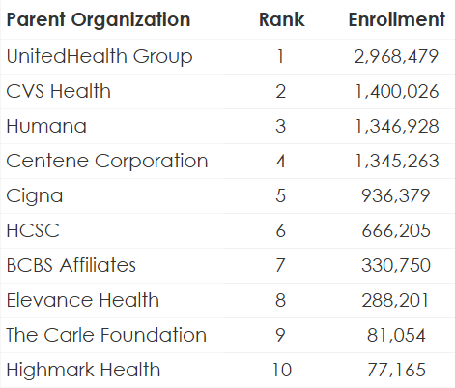
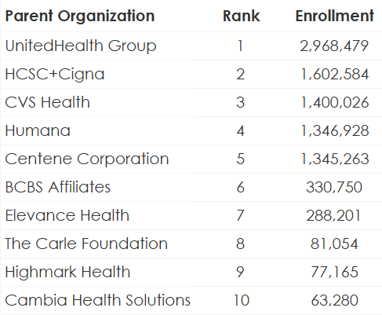
Who are we competing with?
Before Acquisition
After Acquisition
Key Insights
✔ Cigna and HCSC jumped from ranks #5 and #6 to a combined rank #2.
✔ HCSC's enrollment size increased by 140.57% after acquiring Cigna.
10
Notes:
ENROLLMENT BY PARENT ORGANIZATION (before and after acquisition)
DISCLAIMER: Enrollment numbers are pulled from the imputed dataset.

Slide 11
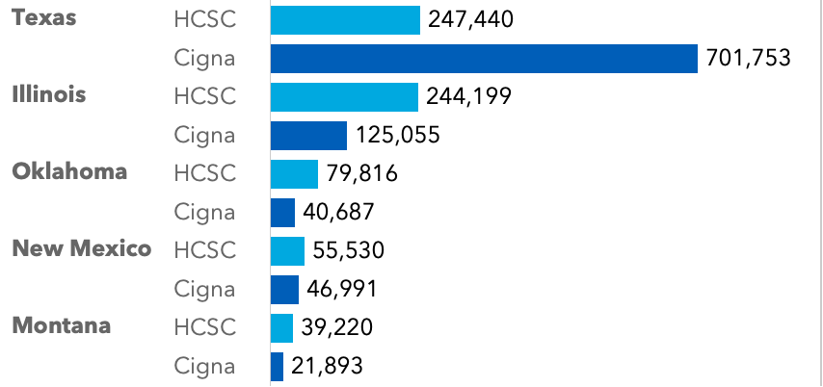
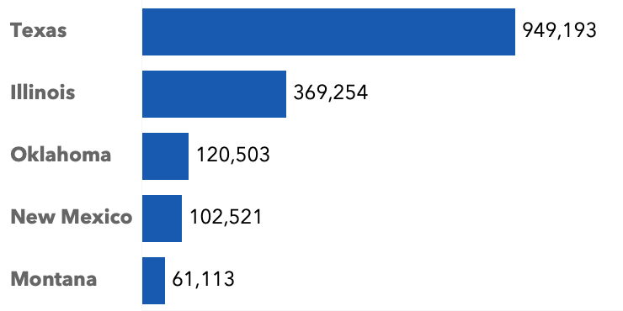
How could enrollment change by state?
Before Acquisition
After Acquisition
Key Insights
✔ Texas enrollment grows 380% ➔ from 250k to 950k.
✔ +50% growth in Illinois ➔ from 244k to 369k.
✔ HCSC secures its spot as a dominant player in Texas.
11
Notes:
ENROLLMENT BY STATE: Enrollment is pulled from the imputed dataset.

Slide 12
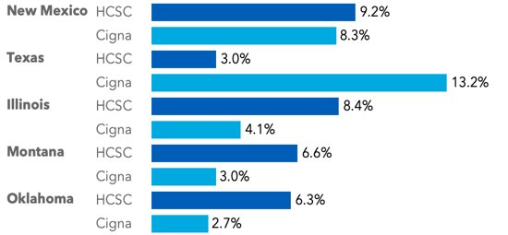
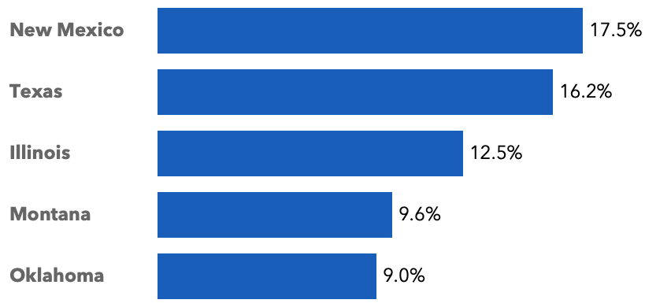
How could state market penetration change?
Before Acquisition
After Acquisition
of 467,195 eligible
of 4,827,499 eligible
of 2,426,883 eligible
of 264,753 eligible
of 811,584 eligible
✔ Texas penetration grows more than 5x post-acquisition (3% → 16.2%).
✔ New Mexico strengthens from 9.2% to 17.5%, becoming a leading market.
✔ Illinois improves from 8.4% to 12.5%.
✔ Montana and Oklahoma have lower penetration (<10%) ― room to grow.
Key Insights
12
Notes:
ENROLLMENT BY STATE: Enrollment is pulled from the imputed dataset.

Slide 13

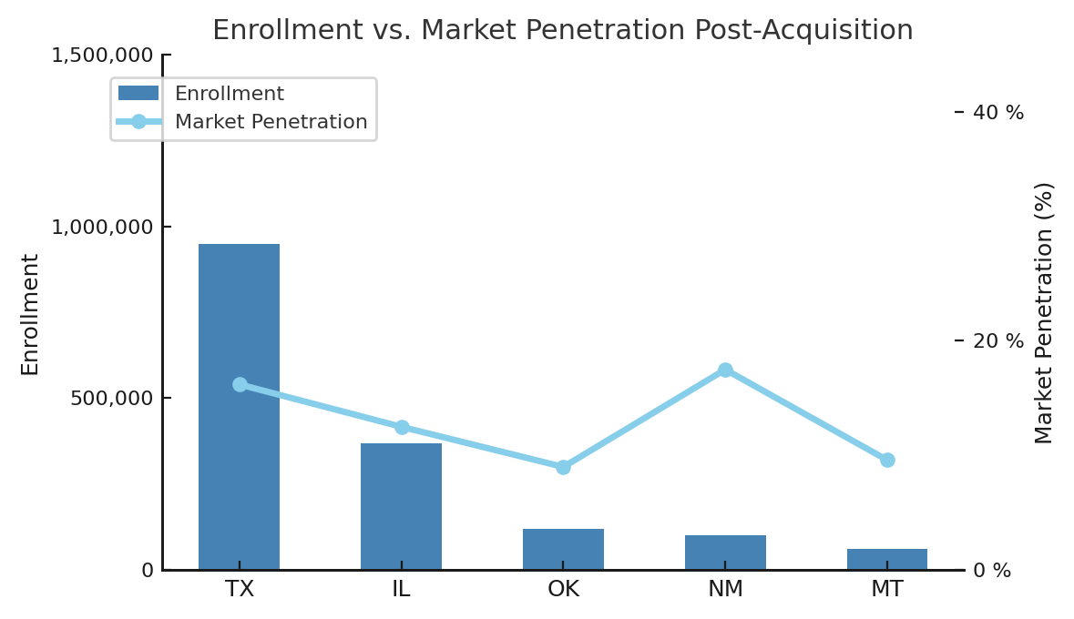

Enrollment vs. Market Penetration
What's the Difference?
Enrollment
Definition
The number of people actually enrolled in a specific plan or with a provider
Example
950,000 people enrolled in a plan
Low enrollment compared to other states, but a high market penetration in NM
Market Penetration
Definition
The percentage of eligible individuals in a market who are currently enrolled
Formula
Enrolled Population
Eligible Population
Example
950,000 enrolled out of 4.8 million eligible = 16.2% market penetration
x 100
Summary
✔ Enrollment shows volume
✔ Market Penetration shows reach or share
13
Notes:
ENROLLMENT BY STATE: Enrollment is pulled from the imputed dataset. Penetration numbers are pulled from the not imputed dataset.

Slide 14
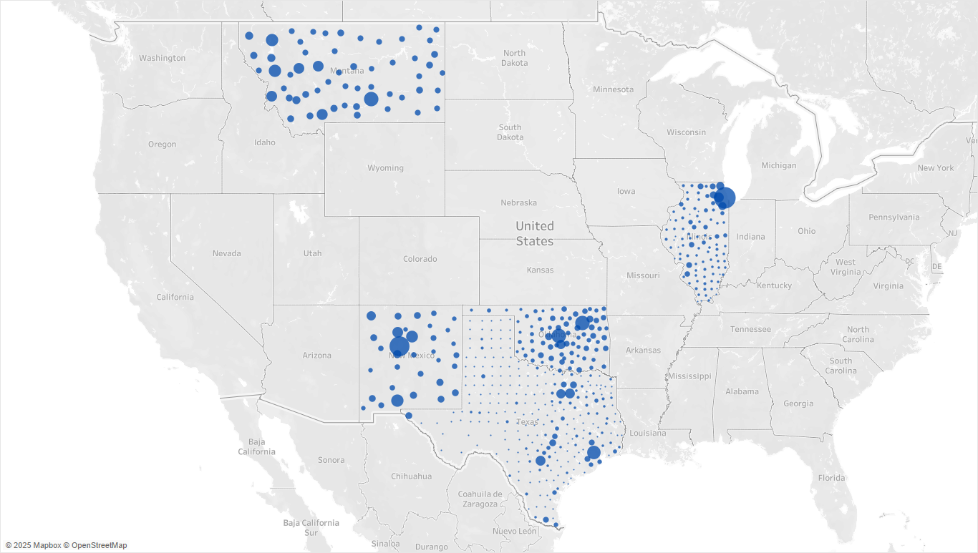
Big Cities, Big Enrollment Opportunities
Highest enrollment and market penetration rates coincide with counties and cities with the largest populations:
Chicago, IL
Houston, TX
Dallas, TX
Oklahoma City, OK
Albuquerque, NM
Billings, MT
What does this mean for HCSC?
Target outreach and tailor resources in high-impact areas.
This framework shifts decision-making from reactive to proactive — empowering smarter interventions in the right places.
14

Slide 15


Beyond market measures, we also need to understand enrollment barriers.
Looking deeper into why some communities remain under served.
To make an impact in eligible populations, we have to understand the communities involved
15

Slide 16






Targeting Opportunity Areas Using Social Determinants of Health
What is the SDOH Opportunity Score?
A weighted index of crucial social and economic variables that allows the prioritization of places with barriers to care and poor outcomes
20% Economic Hardship +
20% Employment Access
+
20% Financial Security +
15% Aging Needs
+
15% Housing Affordability
+
10% Digital Access
=
SDOH OPPORTUNITY SCORE
Why it matters
Highlights counties where Medicare Advantage plans, value-based care models, and community health investments have the highest potential for impact
16

Slide 17
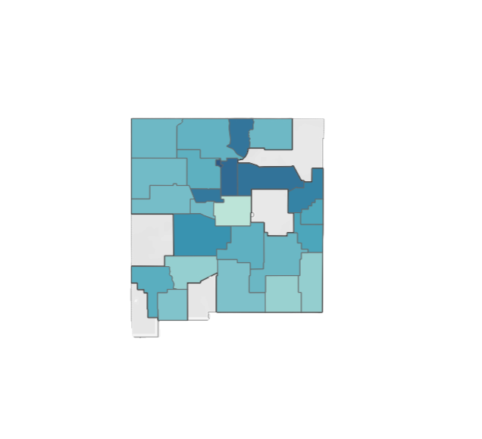
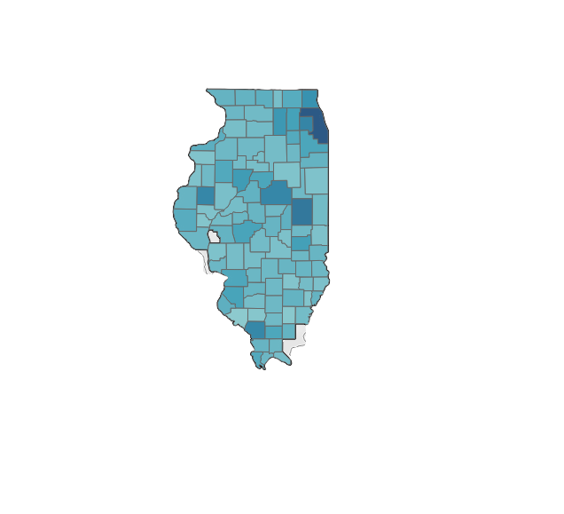
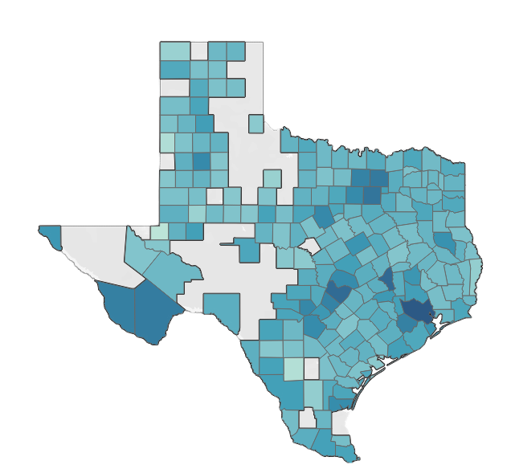
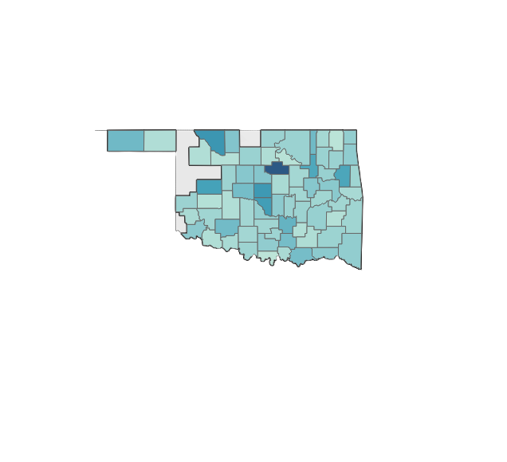
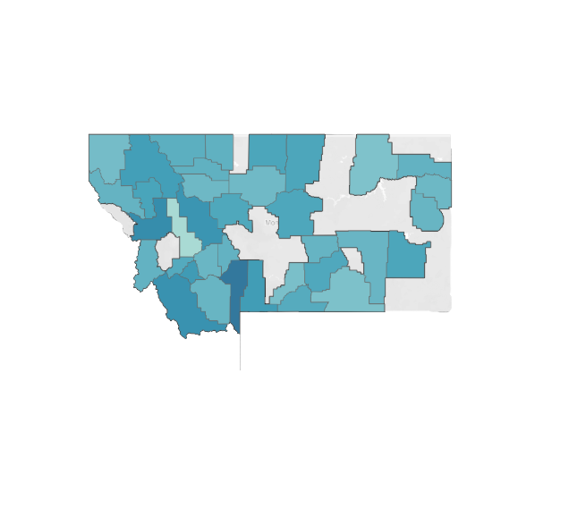
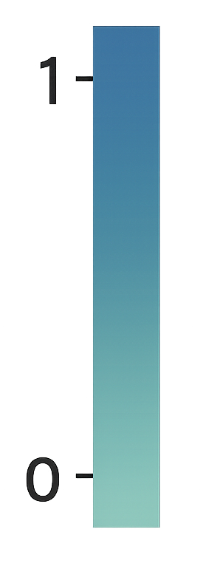
Mapping SDOH Vulnerability for Strategic Action
Montana
New Mexico
Texas
Oklahoma
Illinois
Higher Score = Higher Vulnerability + Higher Potential Impact
Texas, Illinois, and Oklahoma show distinct clusters of high-scoring counties, with the highest scores centering around large cities, indicating areas with elevated SDOH-related need.
The Opportunity Score is used to prioritize these counties for plan expansion, supplemental benefits, and broader health equity strategies.
Score Range | Interpretation
0.80 – 1.00 | Very high SDOH burden
0.60 – 0.79 | Moderate to high opportunity
0.40 – 0.59 | Moderate SDOH needs
< 0.40 | Lower SDOH burden (relatively stable areas)
17

Slide 18

From Community Need to Consumer Perception
To improve Medicare outreach and enrollment in high-need areas, we must understand the environment consumers live in and their perception of healthcare providers.
Enrollment + Market
Plan Offerings
Market Sentiment
SDOH Factors
Understanding the environment, the market, plan offerings, and barriers to care highlight where the need is greatest—geographically and demographically.
These areas often correlate with lower access, higher burden, and lower enrollment.
But, access alone isn't always enough to capture market share.
How people feel about their options—trust, satisfaction, digital access—drives engagement.
18
Notes:
Halee HCSC:
Likelihood to recommend: A significant majority (92%) of customers would recommend HCSC to others.
Policy offerings: 73% of customers are happy with HCSC's policy offerings.
Trustworthiness: A high percentage (81%) of customers trust HCSC.
Renewal intention: A large majority (89%) of customers plan to renew their policies.
Digital experience: Over 70% of respondents are satisfied with HCSC's website and mobile app.

Slide 19
Sentiment Analysis
Reputation Score for Leading Enrollment by Organization
Why HCSC Leads:
Policy Satisfaction
73% satisfaction with policy offerings
Renewal Intention
89% plan to renew policies
Digital Strength
Strong mobile app and website satisfaction (70%)
Organization | Reputation | Key Insights
HCSC | 3 out of 5 ★★★☆☆ | High trust (81%), 92% would recommend
Humana | 3 out of 5 ★★★☆☆ | Existing customers report dissatisfaction with plans
Cigna | 2 out of 5 ★★☆☆☆ | Coverage gaps and controversies over coverage decisions
Centene Corp | 2 out of 5 ★★☆☆☆ | Downgraded Medicare star rating by US regulators
CVS | 2 out of 5 ★★☆☆☆ | Allegations of filling illegal opioid prescriptions and billing federal health insurance programs
UnitedHealth Group | 2 out of 5 ★★☆☆☆ | Trust Issues: Cybersecurity breach and civil fraud investigation
19

Slide 20


Acquiring Cigna – What Next?
Areas of Concern
Features to Maintain
Coverage Gaps: Customers reported frustration with limited coverage for non-standard treatments and in-network doctor availability
Claims Denials: Many experience dissatisfaction due to fast, automated claims denials and unclear benefit explanations
Robust Support Options: Cigna provides 24/7 support for some services and access via phone, live chat, and website tools
AI for Customer Experience: Cigna leverages sentiment analysis and complaint data to identify service pain points and is developing machine learning models for real-time feedback and continuous quality improvement
20

Slide 21




Key External Forces
Push for Personalized Care Plans
CMS 2025 Final Rule
Inflation & Cost Pressures
CMS Expanding SDOH Risk Adjustments
Flexible, customizable plan options
Transparent Messaging & improved services for dual-eligibles
Emphasize value-focused messaging
Plans that address SDOH needs (transportation, food, housing)
21

Slide 22
Persona-based Strategies Post-Acquisition
Recommendations:
Market Medicare Advantage and customizable Special Needs Plans
Highlight better care coordination: dialysis centers, transplant programs, and specialists network
Lower out-of-pocket costs for heavy users of health services.
Recommendations:
Reassure the Cigna acquisition means a larger network, more resources, and potentially lower premiums
Emphasize continuity of care: same doctors, expanded services
Recommendations:
Grandfather coverage in to stabilize benefits as much as possible for the next year or two
Offer additional perks like fitness benefits, dental/vision upgrades, and customer service improvements
Patrick • Age 23, Oklahoma, ESRD
Currently on Federal Medicare
Not directly affected by Cigna acquisition
Potential group that is not enrolled yet
Ryan • Age 42, Illinois, ALS
Already enrolled in HCSC
Could gain expanded networks
Sensitive to changes
Donna • Age 68, Texas, 65+
Currently with Cigna
May feel anxious about change
Must win her trust to prevent switching
22

Slide 23
Turning Insights Into Action
Preserve Strength & Trust
Grandfather in coverage for Cigna customers and focus on transparent value-focused messaging to all enrollees about changes
Meet the Market
Broaden plan type offerings and prioritize increasing enrollment opportunities for individuals in large cities and high-risk SDOH areas
Personalize & Modernize the Experience
Focus on modular Medicare Advantage plans to customize coverage options for special case individuals and promote self-service digital tools for accessibility for all lifestyles
Deploy More Community Centered Initiatives
Further HCSC's current efforts to connect face-to-face with communities by developing outreach and enrollment support programs specific to critical SDOH areas.
Leverage Tools to Strengthen Strategic Advantage
Use custom tools to explore the data further and continue developing these strategies

Slide 24
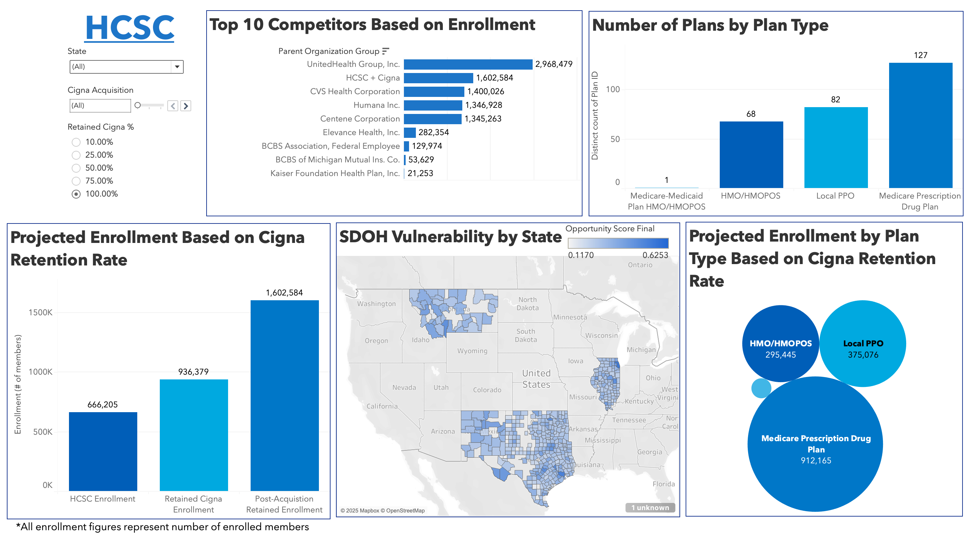
Tableau Dashboard
24

Slide 25
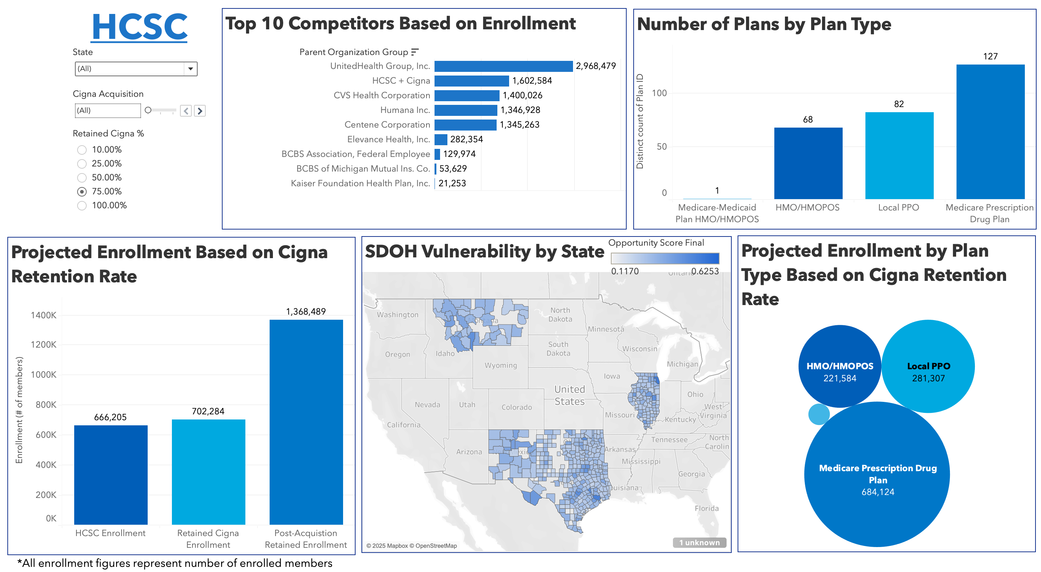
Tableau Dashboard
What is the projected total enrollment post-acquisition if 75% of Cigna's members are retained?
1,368,489
25

Slide 26
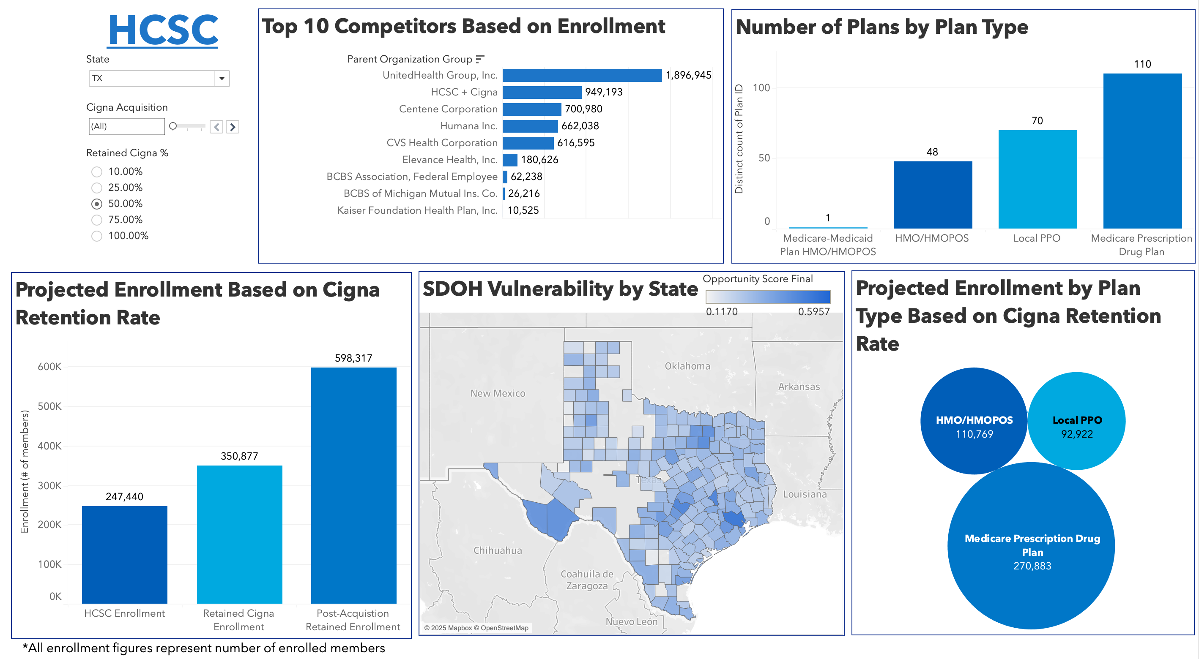
How many members are enrolled in PPO plans across Texas post-acquisition if 50% of Cigna members are retained?
92,922
Tableau Dashboard
26

Slide 27


AI Output & Strategic Opportunities
Medicare Market Intelligence GPT
A custom-built GPT designed to uncover actionable insights using Artificial Intelligence
Built to analyze Medicare enrollment patterns across five strategic states: TX, IL, OK, NM, MT
Automates repetitive analysis, highlights anomalies, and uncovers market trends faster than manual review
What can it do?
Deliver Medicare enrollment insights by analyzing plan-level data across five states
Data Foundation
Draws from CMS Enrollment Files by state, which include plan-level and county- level enrollment data
Limitations
Insights depend on the quality and completeness of the underlying data and need human review
27

Slide 28
AI Takeaways
Keep in Mind:
Garbage in, garbage out. AI will not transform bad data into good. Validate datasets before and after AI.
Humans in the Loop should always be included. Verify and validate all AI generated files and insights.
Be very specific with what you are asking AI, e.g., prompt engineering.
Strengths:
Great for slide outlines, ideas, design, and overall presentation. Prompt the AI for feedback to improve.
Can be used as an aid for data insights based on visualizations or review of data analysis.
Strong at developing open-source coding in multiple languages by aiding as a coding partner.
Condenses large amounts of text to make it more concise and readable for slides.
Weaknesses:
Not good at handling large datasets with millions of records. It chunks and samples data for analysis.
Struggles with text & spelling. When graphics with text are generated, will most likely have misspellings.
Having to continually correct and redirect the output by defining what columns or fields mean for the AI.
Often hallucinates sources or findings. Use prompt engineering to report based solely on valid sources.
Idea overload that results in leading you down a rabbit hole very fast. Be the human factor!
28

Slide 29
0 individuals not enrolled
but eligible for Medicare and still in need of care
0 in Texas (0%)
0 in Illinois (0%)
0 in Oklahoma (0%)
0 in New Mexico (0%)
and 0 in Montana (0%)
An opportunity met with responsibility.
7

Slide 30

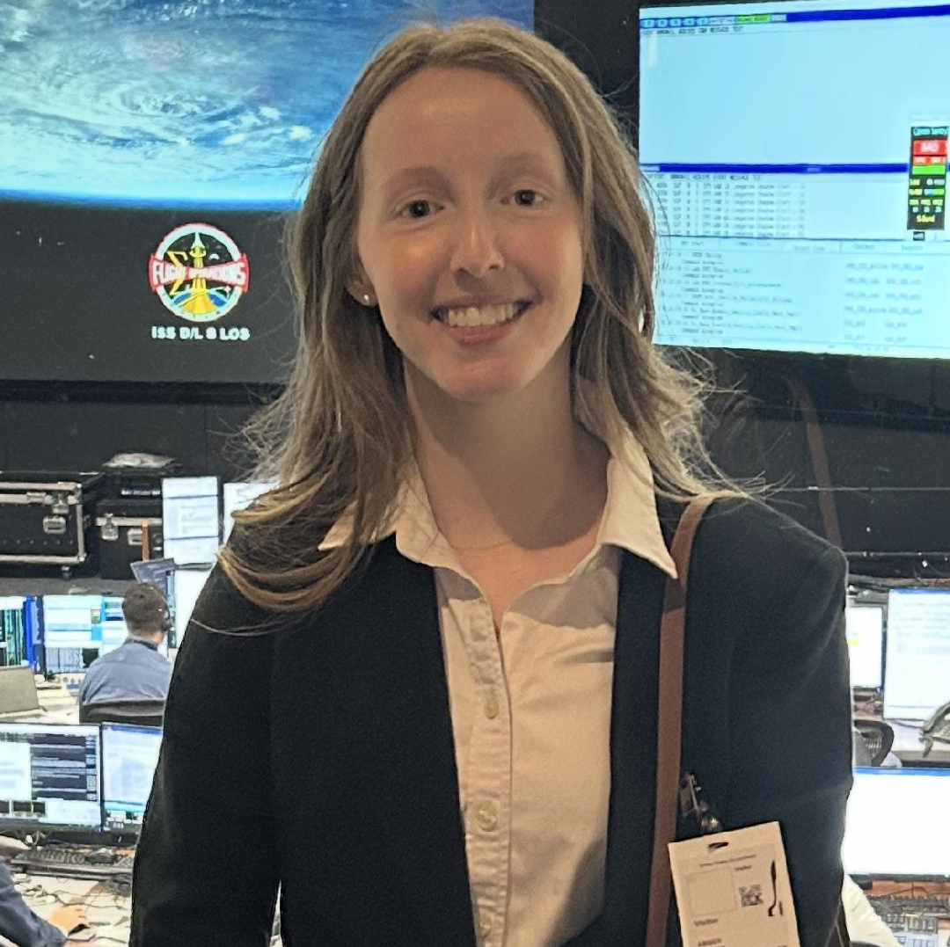
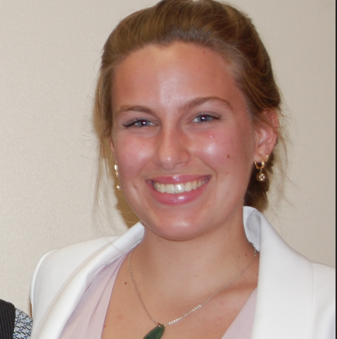







Questions?
Meet the Team & Connect with Us on LinkedIn
Shelby LeBlanc
People Analytics & Business Intelligence
Amber Stokes
ISS Mission Operations Planner
Cecilia Shanks
Aspiring Global Implementation Consultant
Czamantha Bello
Data Analyst
Geri Harding
Senior Data Analyst
Halee LeBoeuf
Identity & Access Management Security Analyst
Kevin Brueggemann
Data Analyst with a strong interest in Sports
Macy Fullilove
Human Resource Analyst
Quynh-Tram Tran
Data Analyst with a strong interest in Healthcare
Shamarria Walker
Data Analyst
29

